Slide 1
3d-Printed Granular Jamming Hand
Melissa Indoe
Chris Kang
Sean Phelan
Maggie Serra
Chris Wallace

Slide 2
Project Background
About 12,500 new arm amputations happen in the US yearly
The vast majority, (77%) are due to trauma
Amputation is a global problem
It is estimated that only half of amputees ever get access to prosthetics
Existing myoelectric prosthetics start at $11,000
This cost is completely prohibitive to many people
The most common form of arm amputation is transradial
Incidence of about 44%
Loss of an arm can severely limit the independence of an amputee

Slide 3
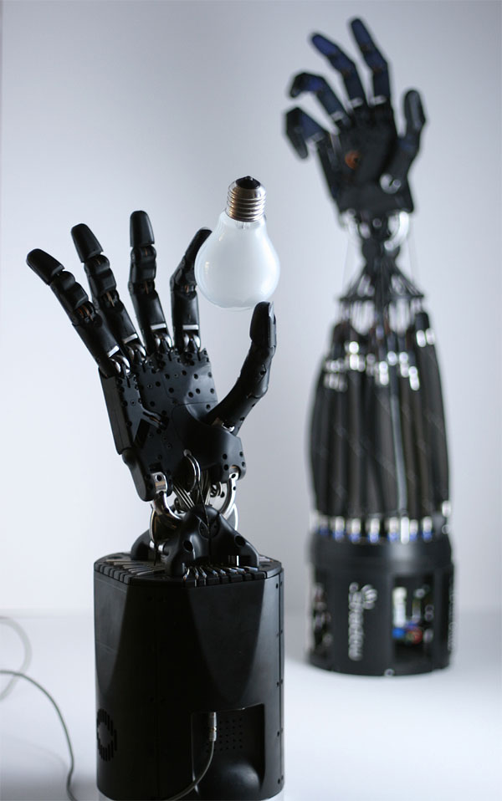
Project Objective
Create a “below-the-elbow” prosthetic hand
The hand should be:
open-source, making it available to anyone anywhere
highly affordable, making it inexpensive enough for anyone to use
high-functioning, giving its owner back their independence in many day-to-day activities
Task-oriented, focusing on dexterity rather than strength
Major issues involved:
Durability
Maintaining dexterity
Keeping costs low

Slide 4
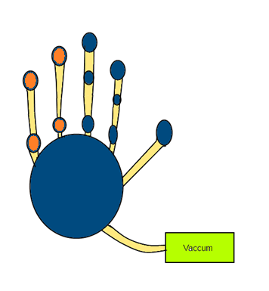
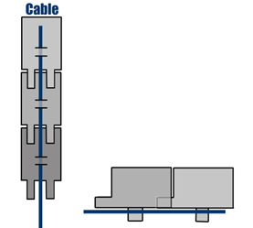
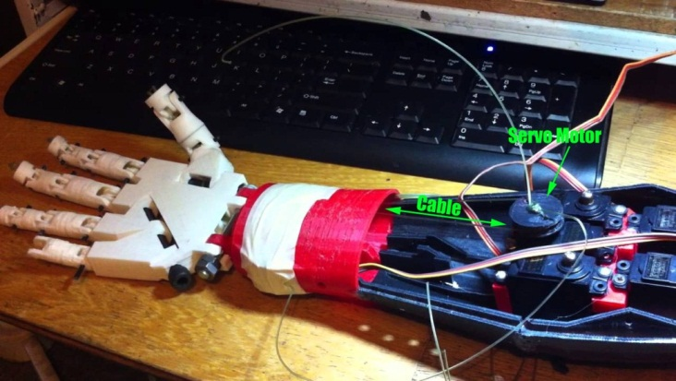
Recap: Phase 1 Conceptual Design
Primary hand design:
Run by 4 cables attached to motors in the forearm
Kept straight via flat springs or dental rubber bands
Grip will be sensed via encoders
Granular jamming pads will be placed with 3 pads/finger on the most active parts of the hand, 2 pads/finger elsewhere
Printed in polycarbonate plastic or possibly ABS
Emulate the size and weight of an average human hand
Printed joint pins
Notes:
Primary hand design notes:
Run by 4 cables—initially it was to be run by 5 but this was simplified due to panel comments
Grip will be sensed via encoders—initially it was thought that the encoders would be necessary to maintain accuracy, this will be addressed later

Slide 5
Major Areas of Concern
Printed joint pins
Are they strong enough?
Are they within the abilities of an average 3D printer?
Material
Is ABS plastic strong enough for this application or is polycarbonate necessary?
Granular jamming pads
Is granular jamming helpful enough to justify?
Is there enough surface area for improved grip?
Can we achieve a vacuum in a reasonable timeframe?

Slide 6
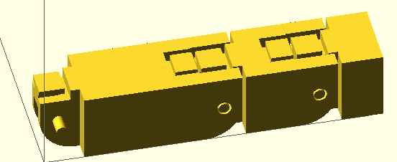
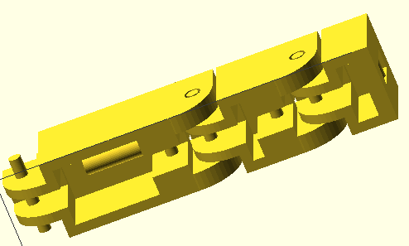
Model for Technical Analysis
A basic model was generated in OpenSCAD
This model included:
Finger segment lengths
Joint pin size
Hinge placement
Through examination, certain “common sense” design adjustments were made
It was decided at this point to use rubber bands rather than flat springs
This was because displacement at the joint interface was quite large
Notes:
As another “Common sense” adjustment, the encoders were eliminated because it was clear that the fingers would not need that level of percision

Slide 7
Areas of Analysis
Force Analysis on a Finger
Joint Pin Analysis
Granular Jamming Analysis

Slide 8
Force analysis of a finger

Slide 9
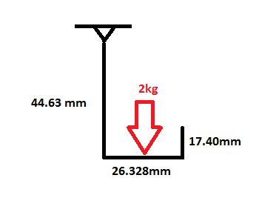
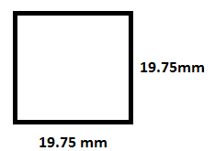
Force Analysis on a Finger
Assumptions:
The mass of the finger segments are negligible compared to the mass of the force
Square cross section

Slide 10
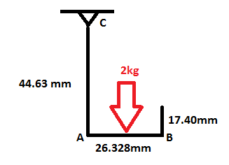
Calculations
Moment about A
M=Force x Distance
M=(2 kg*9.81 m/s²) x (0.026328 m/2)= 0.258 Nm
Bending Stress in AB
σ_{b}= My/I
I=b⁴/12 = (0.01975m)⁴ /12 = 1.27 x 10⁻⁸m⁴
σ_{b}= (0.258Nm)(0.01975m/2) / 1.27 x 10⁻⁸m⁴
σ_{b}= 200.3 kPa

Slide 11
Calculations
Max Shear Stress in AB
Ʈ=3F/2bh
Ʈ =[3(2kg*9.81m/s²) / 2(0.01975m)²] = 75.4 kPa
Normal Stress in AC
σ_{n}= F/A
σ_{n}= (2 kg*9.81 m/s²) / (0.01975m)² = 51.3 kPa

Slide 12
Maximum Stress
Maximum stress occurs in segment AC, on the inner side of the finger.
σ_{max} = σ_{b} + σ_{n}
σ_{max} = 200.3 kPa + 51.3 kPa
σ_{max} = 251.6 kPa

Slide 13
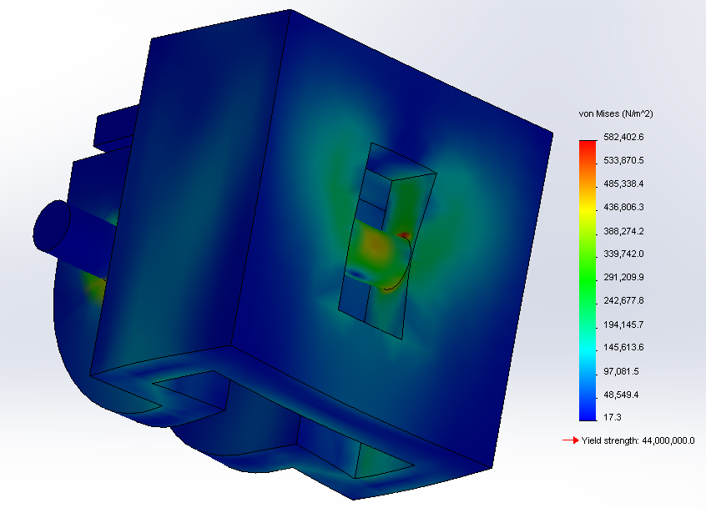
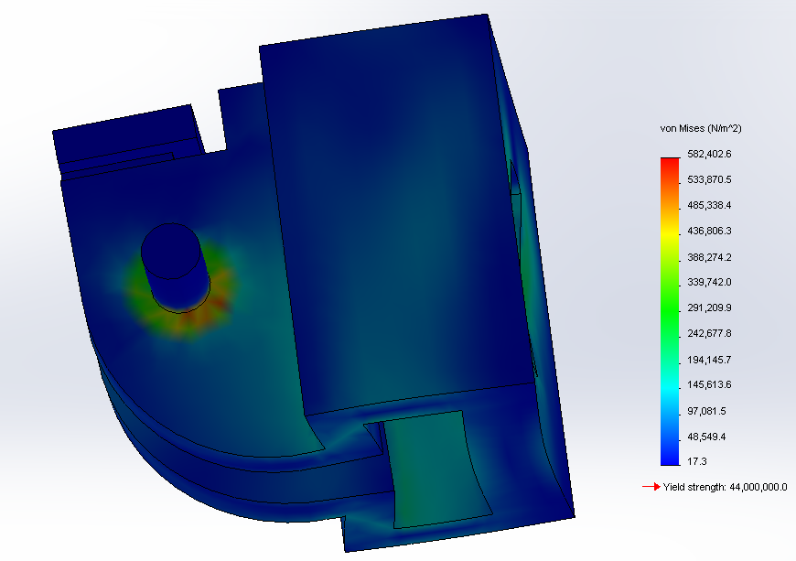
Technical Analysis—Joint Pin Stress
This model was then imported into Solidworks
Force studies were run on individual finger segments
Under standard working conditions, joint pin stresses never approached yield stress
Yield stress of ABS: 44 MPa
Maximum stress under working conditions: 13.8 MPa
Factor of Safety: 3.2
Analysis of “FingerTip” segment

Slide 14
Joint Pin analysis

Slide 15
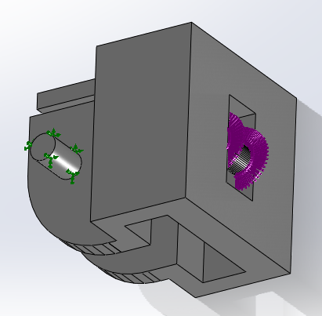
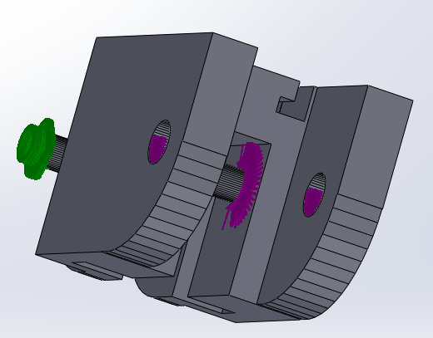
Terms of the Joint Pin Stress Analysis
Material: ABS plastic
Force: 4.5 N
The maximum force incurred by the selected servos
Fixed position: the joint pins
Pulling the wire inward grinds the joint pins against the hinge
Force application:
The point of connection at the fingertip
The joint holes and wire guides elsewhere
Diagram of force application (purple) and fixed position (green) of finger segments

Slide 16
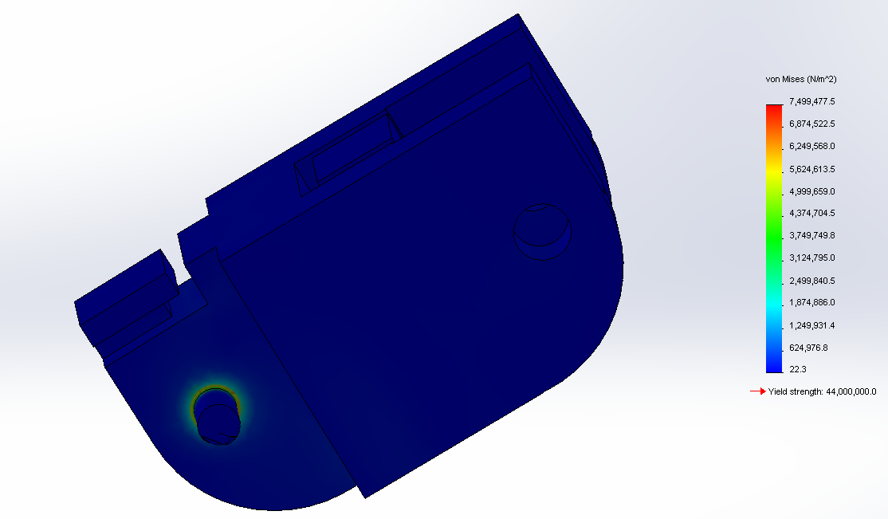
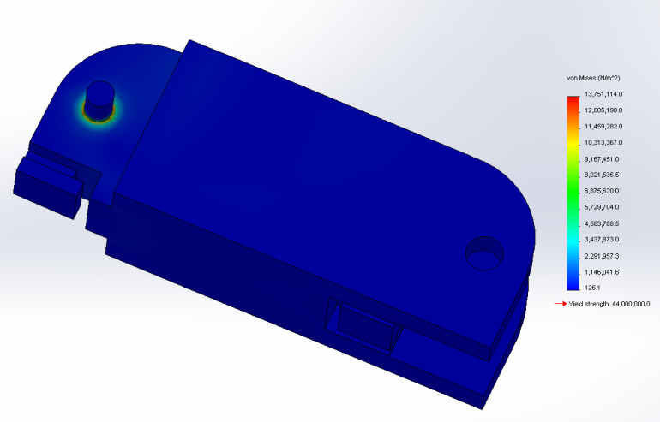

Joint Pin Stress Analysis (continued)
Top Left:
Analysis of “FingerMid” segment
Top Right:
Analysis of “FingerBase” segment
Bottom Left:
Detail of stress concentration at the joint pin interface

Slide 17
Joint Pin Analysis (Continued)
The joint pin analysis showed that ABS passed with flying colors
Therefore the idea of printing the project in polycarbonate plastic could be eliminated
Although polycarbonate is much stronger, it requires a specialized extruder to print correctly
It is also far more expensive than either ABS or PLA
This also suggested testing the joints with PLA plastic
PLA also passed these tests
Yield stress of PLA: 47.8 MPa
Maximum stress under working conditions: 13.8 Mpa
Factor of Safety: 3.5

Slide 18
Additional Solidworks Analysis
In an attempt to differentiate more between PLA and ABS plastics, two additional tests were run:
First, a drop test, since it was very realistic that something designed to be used and removed often might fall
Second, a test of ultimate strength, to see what worst-case conditions the hand could endure
Terms of these analyses:
Drop test:
Dropped from 1.5 meters high on a simulated concrete floor (worst case scenario)
Load to Failure test:
Two tests were run here:
Worst case scenario: all force is transferred to joint pins
Realistic scenario: force is transmitted to joint pins and top edge

Slide 19
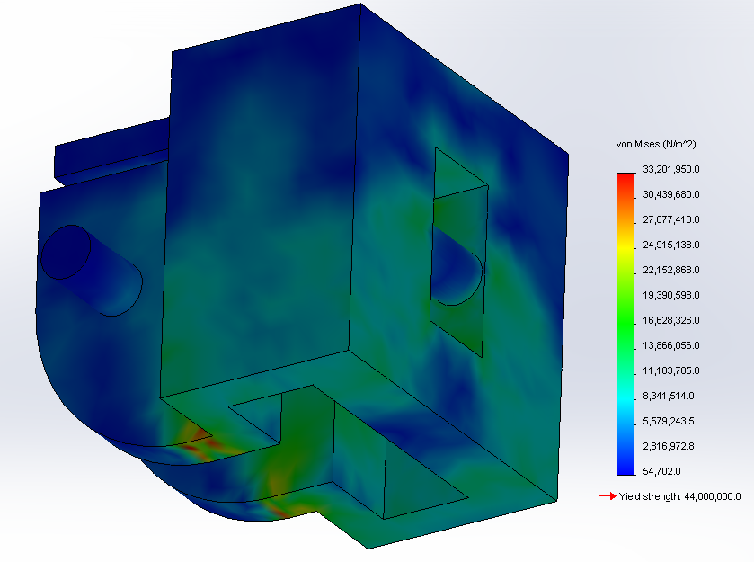
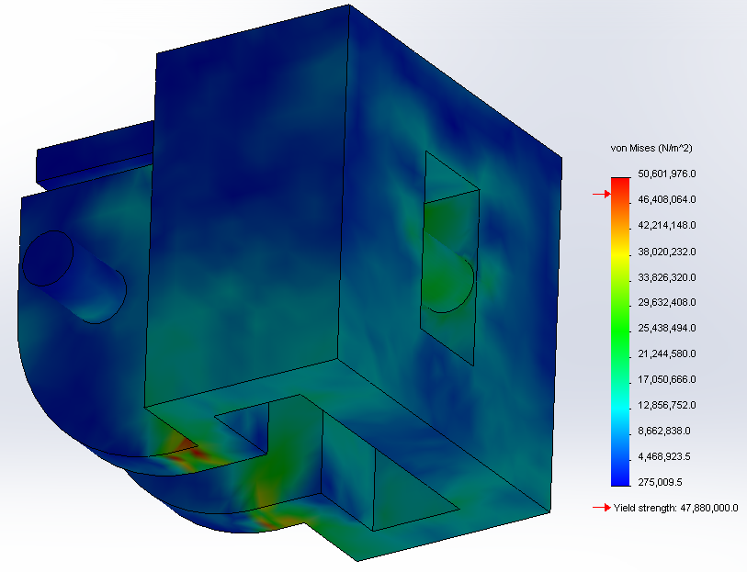
Solidworks Drop Tests
ABS incurred a maximum stress of 33.2 MPa, just 11 MPa short of failure
PLA incurred a maximum stress of 50.6 MPa, which was larger than its yield strength, 47.8 MPa
Conclusion: ABS gets a narrow pass and PLA fails
“FingerTip” drop test with ABS (top) and PLA (bottom)

Slide 20
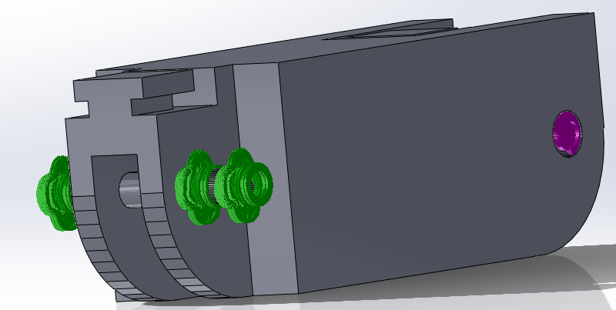
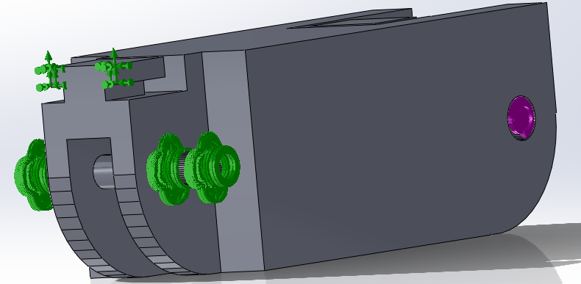
Terms of Load to Failure
Situation: Bending finger backward
Bending it forward would only push it into the palm, which would protect it from damage
Force application:
Through the joint pin holes (up and back)
Definition of “Failure”
Applied stress is greater than yield strength
Pins were analyzed at base only
Two tests were run for each material
“Worst case scenario”—force is only applied to joint pins
“Realistic scenario”—joint pins elastically deform and the top edges make contact with other hinge
Worst case (top) and realistic case (bottom) diagrams of force application (purple) and fixed position (green)
Notes:
“Applied stress is greater than yield strength” was chosen because if the joint pins are bent, then they are useless (they don’t just have to be sheared off)
Pins were analyzed at base only because base incurs the largest stress due to the fact that it has the whole finger acting as a moment arm

Slide 21
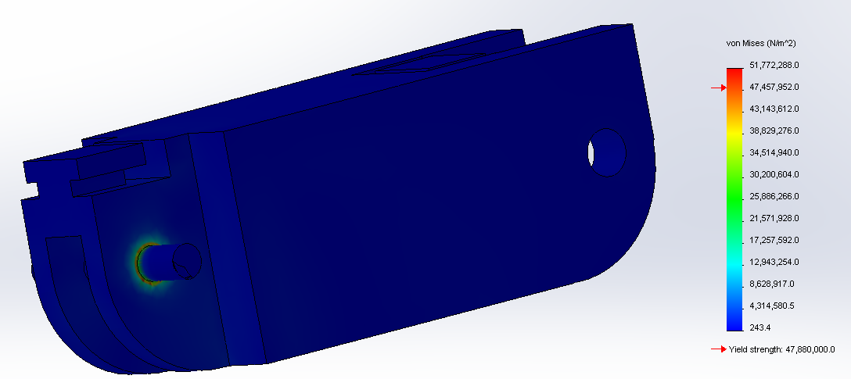
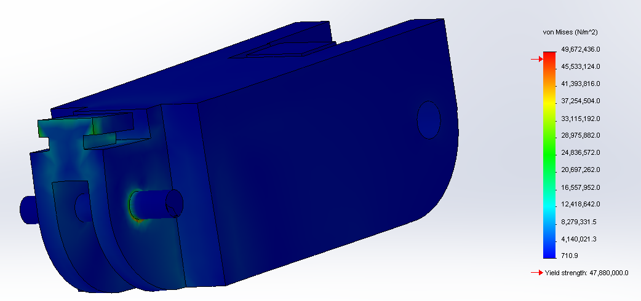
Solidworks Load to Failure
In worst case scenario, both materials failed at just under 15 N
In realistic scenario, ABS failed at ~40 N, and PLA failed at ~43 N
In this test, both materials are comparable
Conclusion: Both materials are passable, but ABS is better (due to passing the drop test)
Worst case (left) and realistic (right) loading scenarios.

Slide 22
Next Point of Analysis—Manufacturability
This design requires printing of floating joint pins
If the fingers are to be printed in one piece as a non-assembly model, there is no way around floating joint pins
This is extremely problematic because the printer must lay filament in midair with no support—anything manufactured this way will be warped.
Therefore it is necessary to see if the warping of the joint pins is acceptable, or if another design must be found
One other major aspect of printing an articulated non-assembly model is that it has to have proper clearances
If clearances are incorrect the model will fuse together

Slide 23
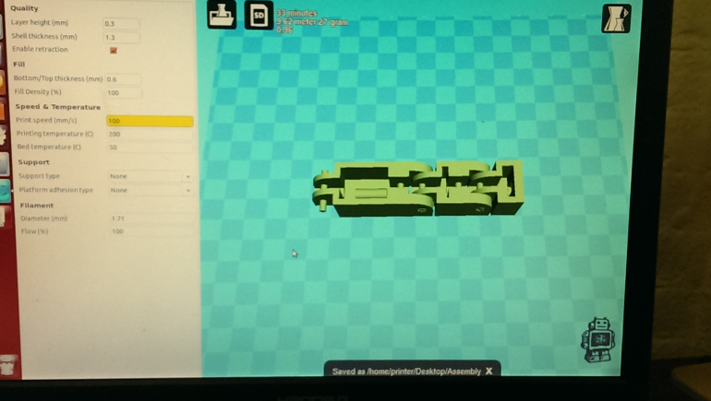
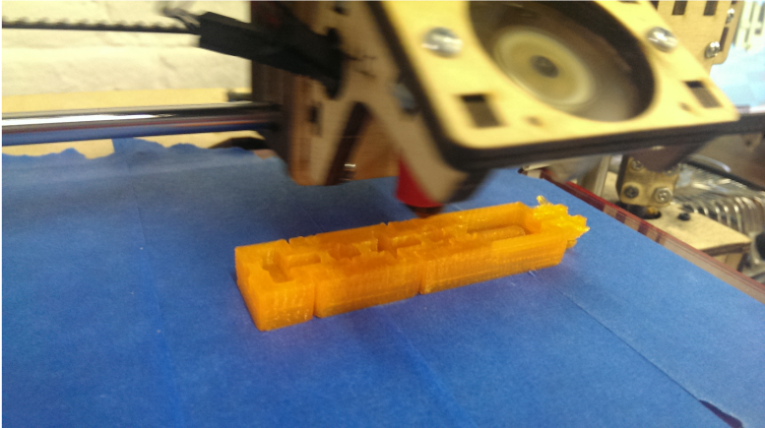
Manufacturability
To test manufacturability of the finger, a test print of the model was performed
Part of the draw of 3D printing is that material is extremely cheap and readily accessible
This means that a project like this can be printed at an early stage, dealing with many manufacturing issues early on
This print weighed 27 grams (well within limits for a human finger)
It cost about 33 cents in material
It took only 30 minutes to create (well within reasonable time constraint for prosthetic manufacture)
Model display in the Repetier software (left) and model in the process of printing (right)
Notes:
Too much text

Slide 24
Manufacturability
Points of failure were identified
Tolerances were too small
Hinges were fused
Joint pins were too warped for the design to function
Positive points were also identified
Rubber band guide overhangs printed successfully
Wire guide functioned with no issues
Scaling was perfect
Notes:
Tolerance was set to .5, well above the .04 mm that 3d printers should be capable of, but of course real life often isn’t like simulations.
To be fair part of this is the quality of the plastic here. This plastic was extruded at too high a temperature, which accounts for a lot of the “goopy” appearance (as well as some of the slop in the dimensions)

Slide 25
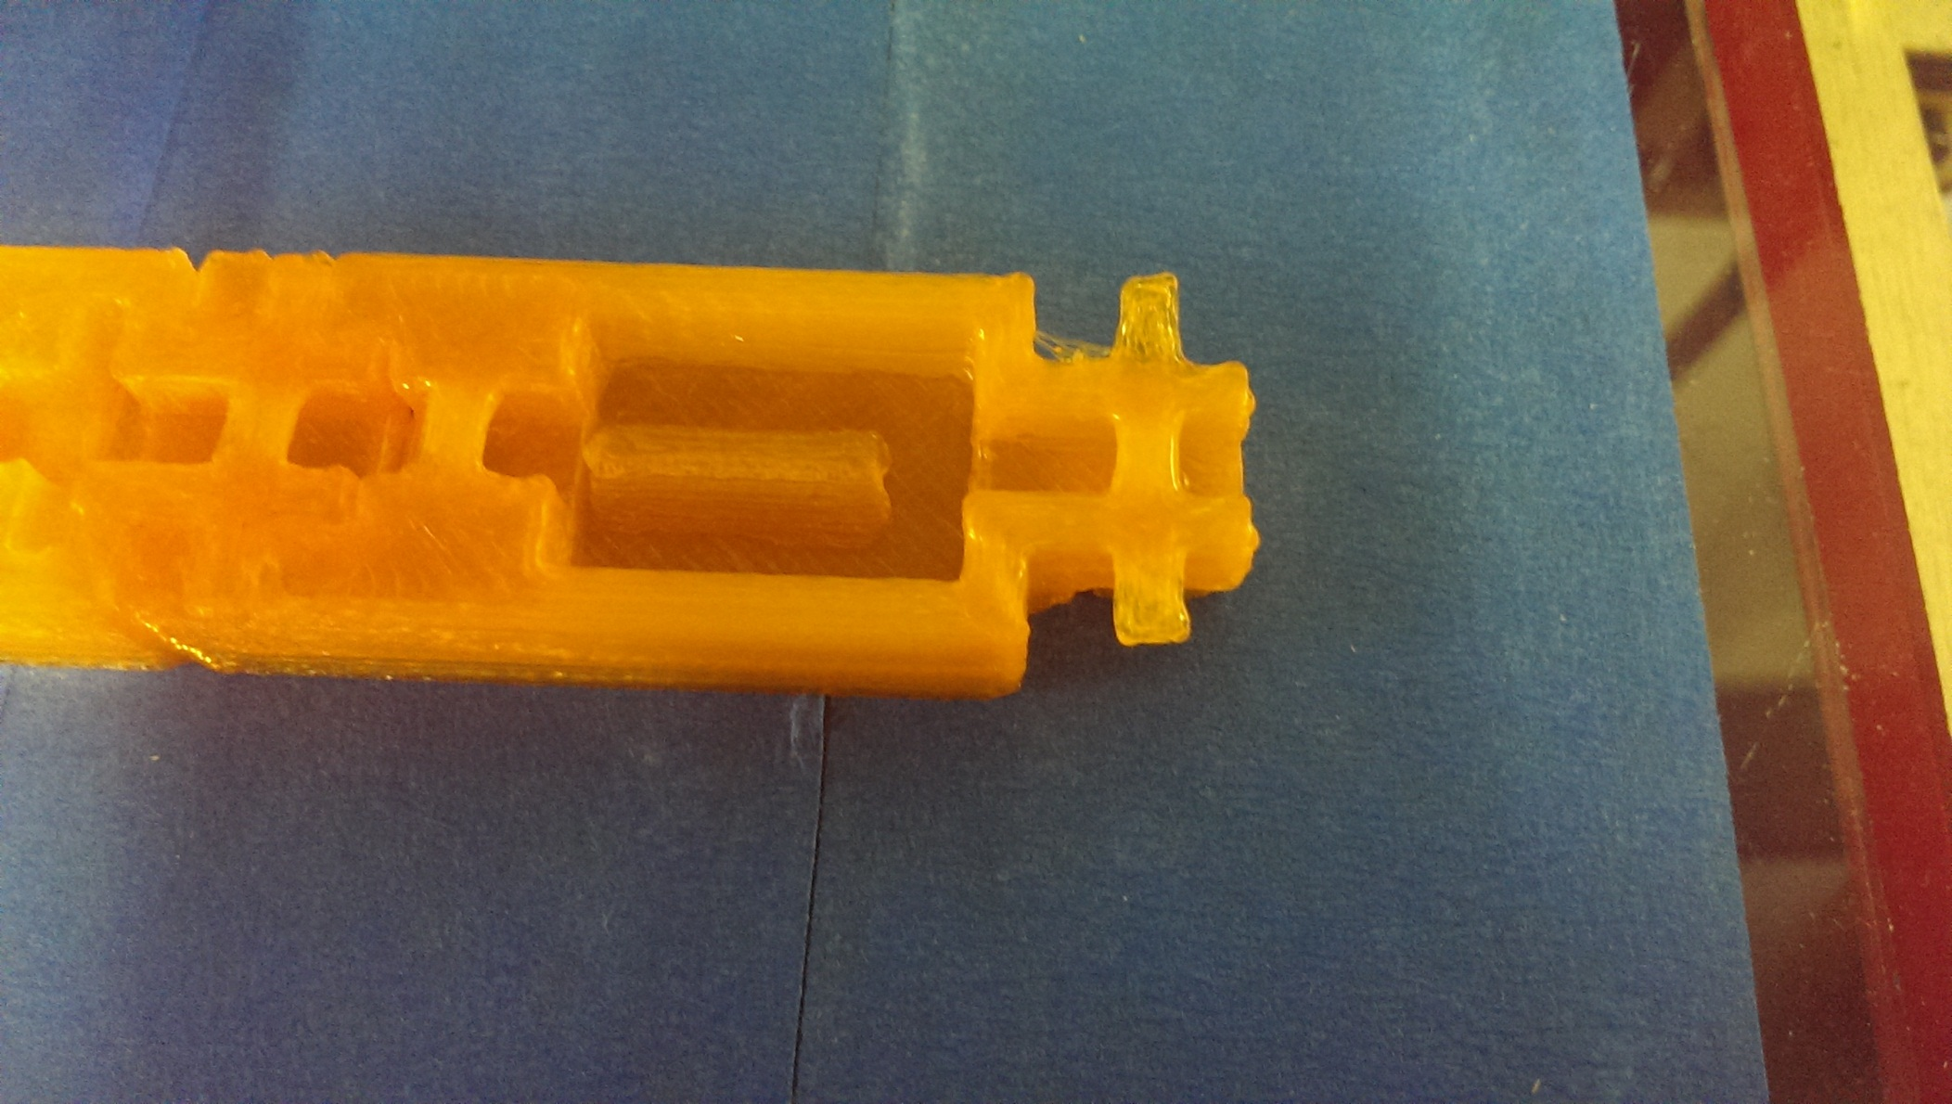
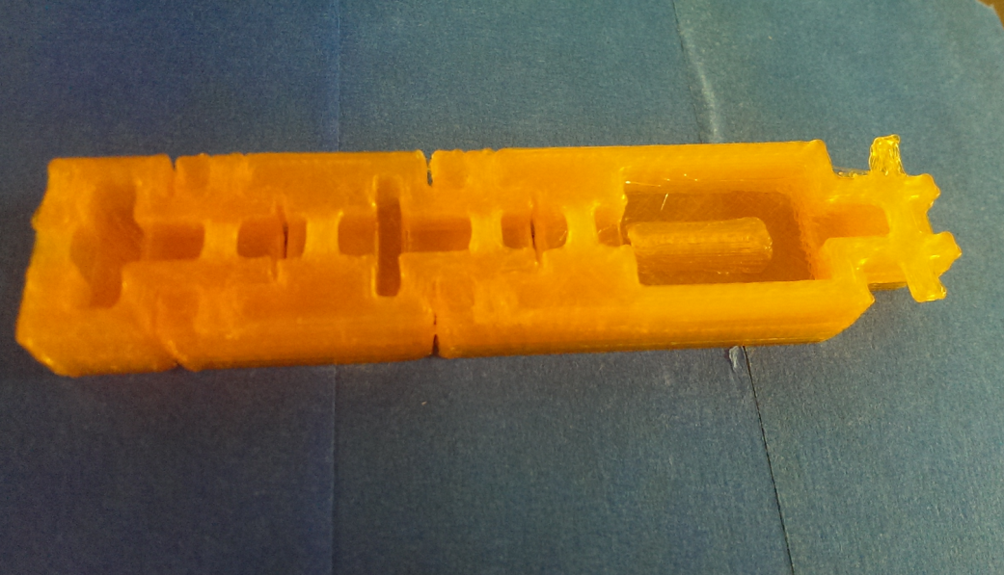
Manufacturability—The Bad
Joint tolerance has been set too low, plastic has bridged the points of articulation and the finger is solid.
Joint pins are definitely too rough for a plastic-on-plastic joint interface as was originally planned

Slide 26
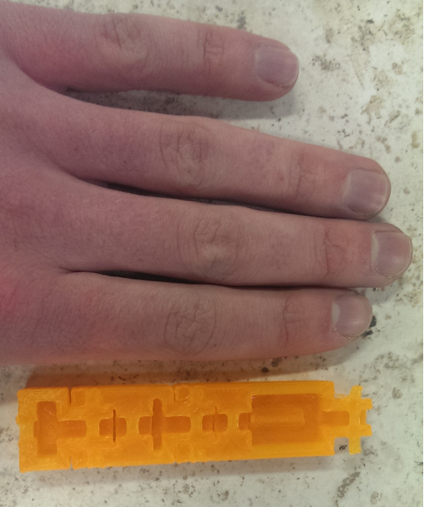
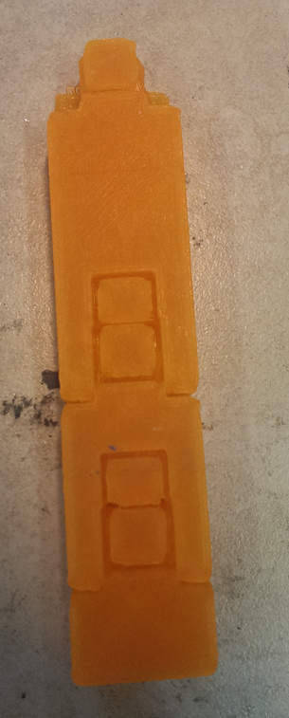
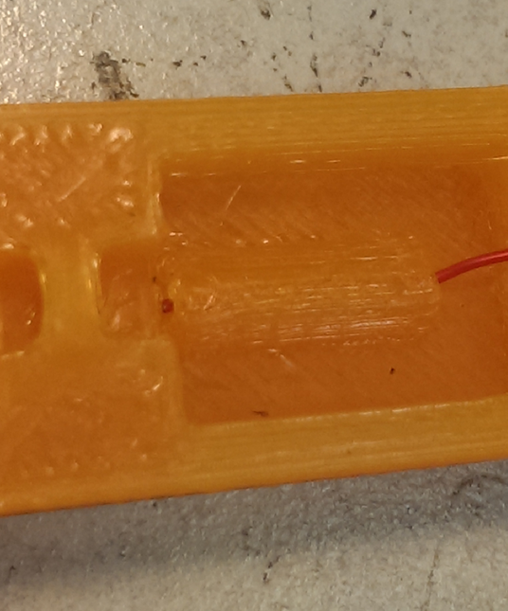
Manufacturability—The Good
The scaling (left), rubber band guides (center) and wire guides (right) are all correct and functional.

Slide 27
Manufacturability—What does it mean?
Based on these findings it should be completely reasonable to use 3D printing as the method of manufacture
It is more than possible to achieve the necessary detail at the needed scale (with some modification)
Modifications required:
Larger joint clearances
Avoid joint pin on plastic contact

Slide 28
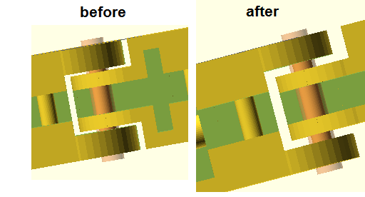
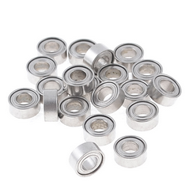
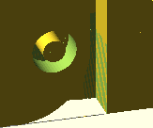
Manufacturability—Solution
Joint clearance was greatly increased
Bearings were introduced in order to solve the problem of warped joint pins
The plastics involved are very pliable (especially when hot)
Applying a heat gun and then press-fitting a bearing into the joint will solve all friction issues
A clearance the size of a bearing (2mm) between parts will never bridge or fuse
Left to right: Improved joint clearances, bearings, bearing clearance.

Slide 29
Granular jamming analysis

Slide 30
Technical Analysis: Granular Jamming Tests
I NEED CHRIS WALLACE AND CHRIS KANG’S TESTS TO WRITE THIS

Slide 31
Calculation
Weight threshold=1 lb
ΔP= 75kPa
F=P*A, F=1lb=.453kg=75000Pa(A),
Diameter=8.7mm,
10mm standard tubing will be used

Slide 32
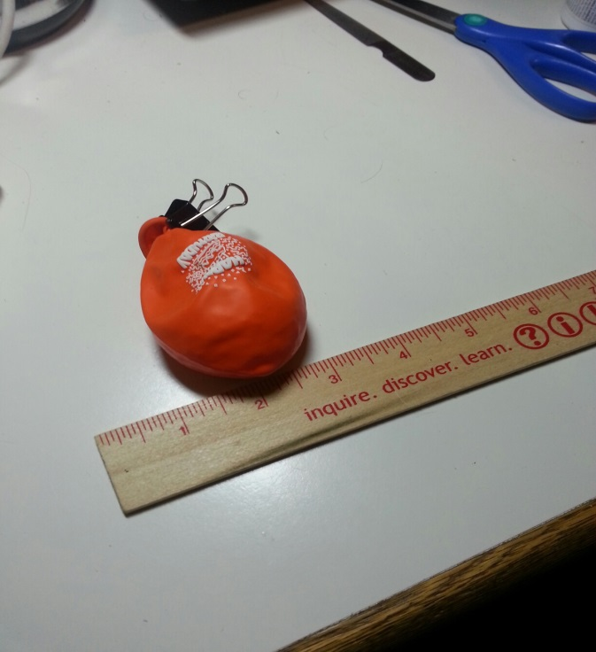
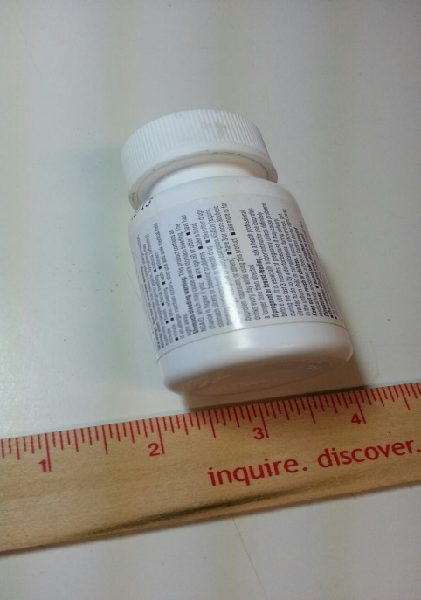
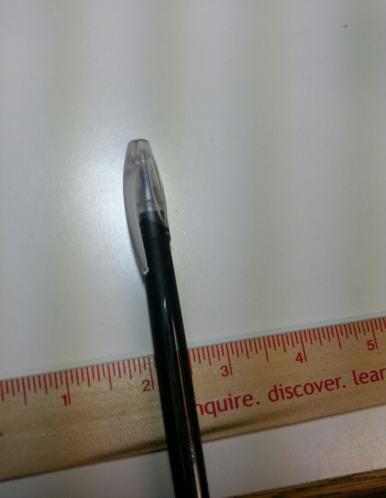
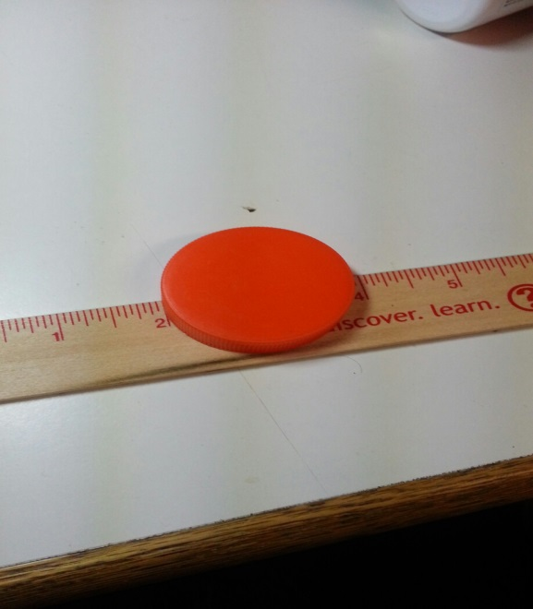
Testing

Slide 33

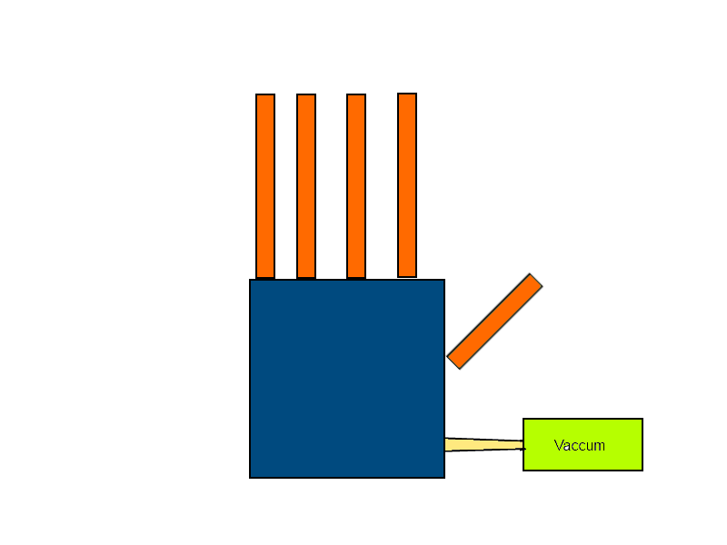
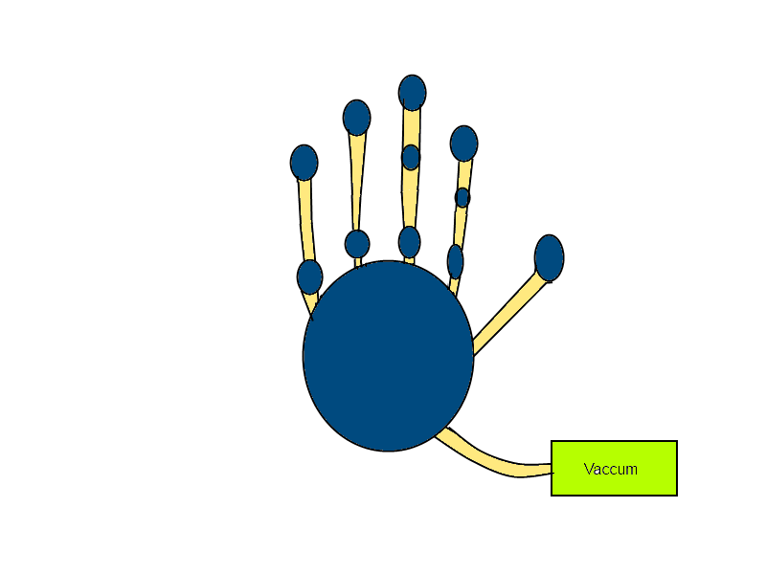
New Proposed Design
Old Design
New Design

Slide 34
Addressing Major Areas of Concern
Printed joint pins
Are they strong enough? YES
Are they within the abilities of an average 3D printer? Yes, with bearings
Material
Is ABS plastic strong enough for this application or is polycarbonate necessary? ABS is fine, PLA is also suitable
Granular jamming pads
Is granular jamming helpful enough to justify? ???
Is there enough surface area for improved grip? ???
Can we achieve a vacuum in a reasonable timeframe? ???

Slide 35
Review: Phase 2 Conceptual Design
Primary hand design:
Run by 4 cables attached to motors in the forearm
Kept straight via dental rubber bands
Grip will be sensed via servos
Granular jamming pads will be placed on the palm only
Printed in ABS
Emulate the size and weight of an average human hand
Printed joint pins (as long as bearings are present)

